Slide 1
Comprehensive Digital Marketing
Project Work
Brand/Topic for the Project : LAKME
Team Lead : YELLAMELLI SAI AMRUTHA
Team Members : PALLEPOGU SRUTHI
ASHA MOUNIKA MOKARA
Y NANDHA VARDHAN
MD BASHEERULLA

Slide 2
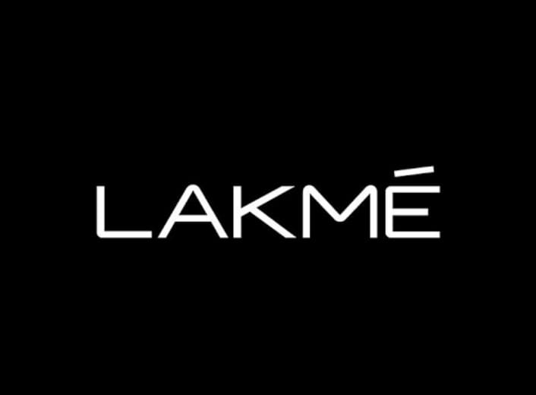
Part 1: Brand study, Competitor Analysis & Buyer’s/Audience’s Persona
Research Brand Identity: Study the brand's mission, values, vision, and unique selling propositions (USPs).
Topic: LAKME https://www.lakmeindia.com/
Brand colours: Monochrome colours, pink and white theme (earlier)
Logo:
Mission/Values: Lakme’s mission is to work to create a better future everyday. It helps people feel good, look good and get more out of life with brands & services that are good for them as well as for others. It inspires people to take small everyday actions that can add up to a big difference for the world

Slide 3
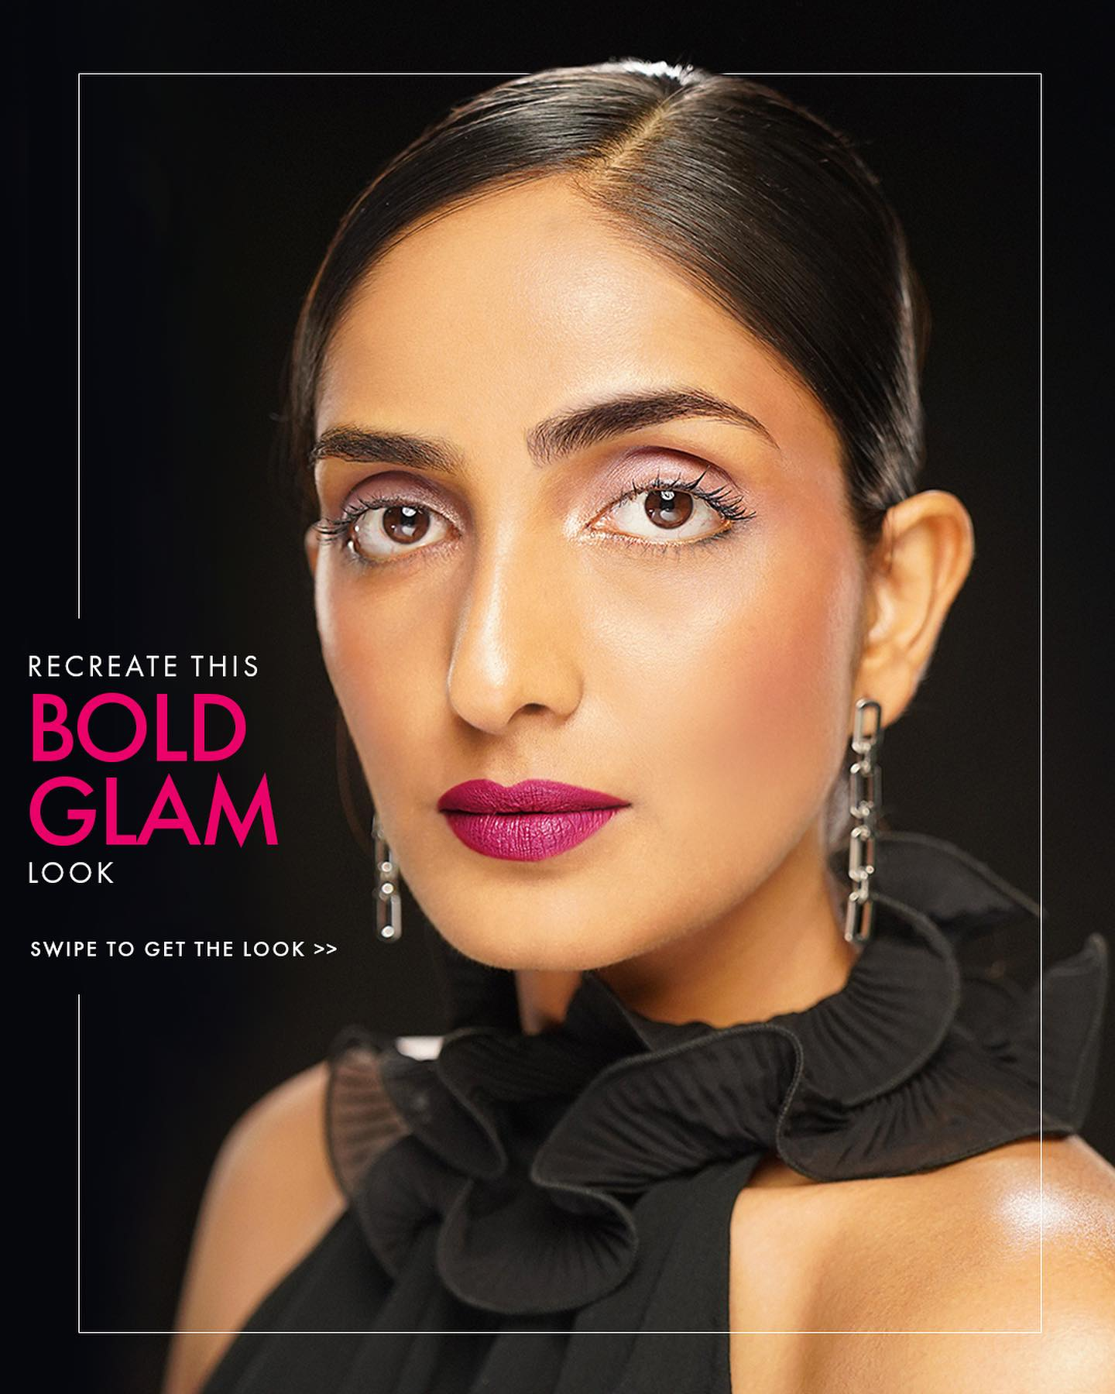
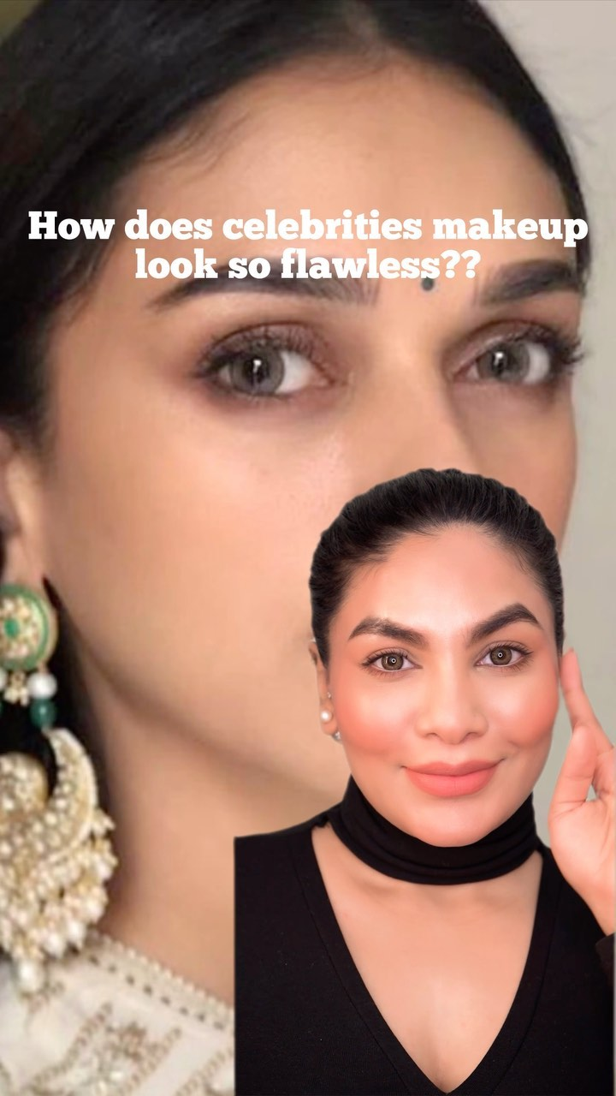
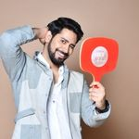
Part 1: Brand study, Competitor Analysis & Buyer’s/Audience’s Persona
USP: The USP for Lakme is it offers products at low prices & high quality compared to other brands, virtual try on feature.
Examine the brand's tagline: Effortlessly, Fashionably, Unapologetically ME
Analyze Brand Messaging: The brand messaging is mostly professional and informative.
It also includes some influencer content, tutorials, campaigns etc…

Slide 4
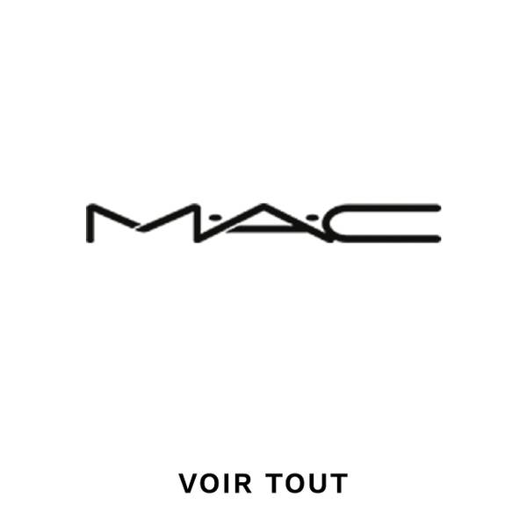


Part 1: Brand study, Competitor Analysis & Buyer’s/Audience’s Persona
Competitor Analysis: Select three competitors operating in the same industry or niche as the chosen brand, examine their USPs and online communication.
Competitor 1: MAC Cosmetics https://www.maccosmetics.in/
USP: Categorization, Live chat with expert, book a service
Communication: User generated content & Tutorials
Competitor 2: Loreal Paris https://www.lorealparis.co.in/
USP: Beauty magazine, Virtual try on for skin & hair
Communication: Influencer content and informative content.
Competitor 3: Maybelline https://www.maybelline.co.in/
USP: Tips for good makeup, categorization & interactive website
Communication: User generated content, collaborations & informative content

Slide 5
Part 1: Brand study, Competitor Analysis & Buyer’s/Audience’s Persona
Buyer's/Audience's Persona: Clearly define the target audience for the chosen brand. Consider demographics, psychographics, behaviors, and interests.
Target Audience: Female
Demographic factors:
Age: 18 to 55 years
Marital status: Married/Unmarried
Location: Metro cities, Tier1 and Tier2 cities (majorly)
Income: 3 to 5 LPA
Education: Min 10+2
Communication: TV ads, YouTube, Instagram and Facebook

Slide 6
Psychographic factors:
What is important for them when considering products?
Price, reviews and brand.
What are the objections that they may have for purchasing products?
Incomplete ingredient list, reviews, quality and sometimes the price.
What is the value that your products will add to their professional life?
As a cosmetic brand it will help in making the best personal appearance of the person irrespective of the industry they belong to.
What drives their decision making process?
Sometimes the decision making process depends on the price, reviews, how familiar the brand is.
Behaviours & Interests:
Lifestyle: Modern & traditional lifestyle
Social class: All classes of the society (upper, middle & lower class as well)
Interests: To look beautiful, elegant & trendy, to have good skin (skincare)

Slide 7
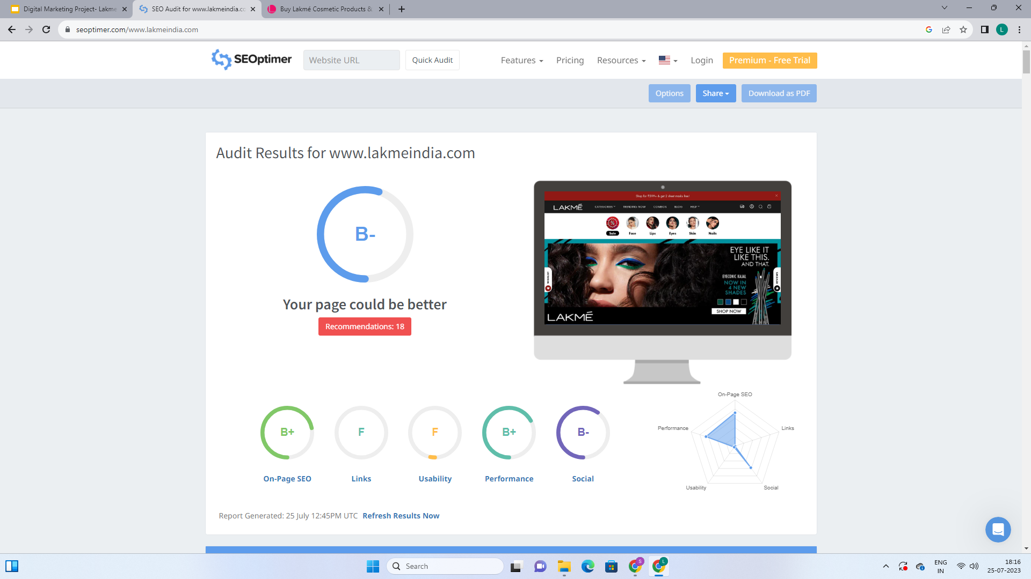
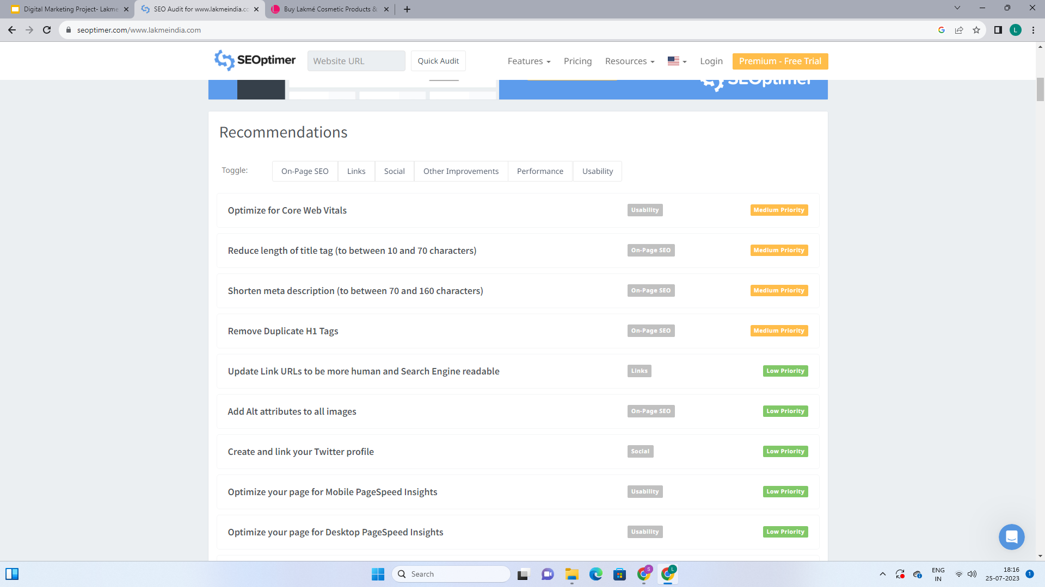
Part 2: SEO & Keyword Research
SEO Audit for Lakme website:

Slide 8
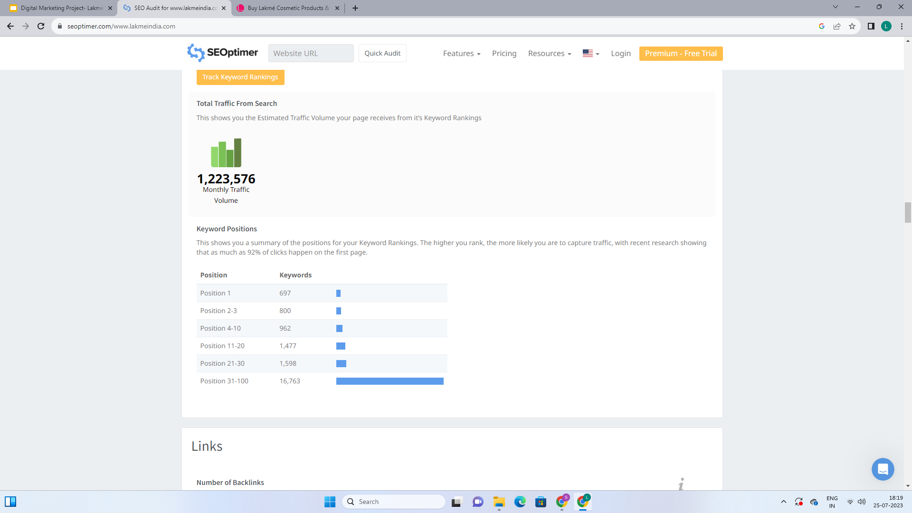
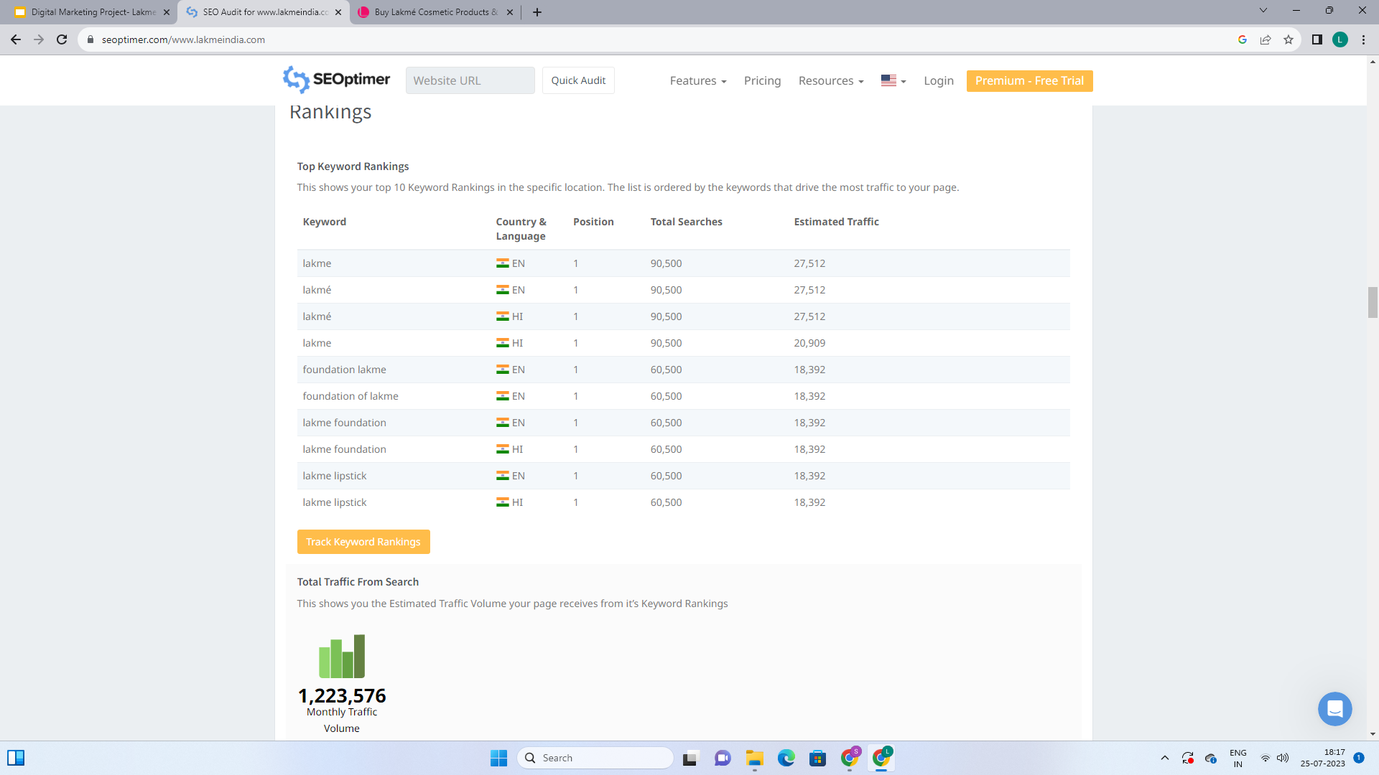
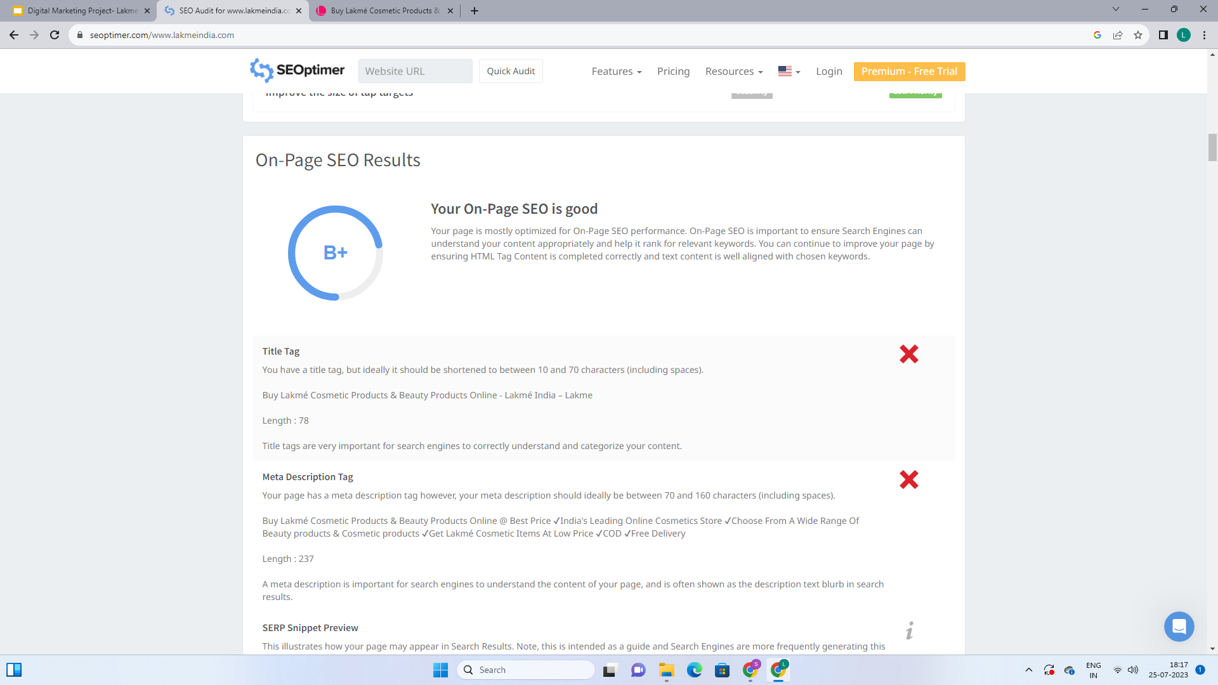

Slide 9
Keyword Research:
Research Objectives: The following are the research objectives
Improve SEO and Organic Traffic: By researching relevant and high-traffic keywords, you can optimize your website's content to align with what users are searching for. When your site ranks higher in search engine results for relevant keywords, it increases the chances of attracting organic traffic, as people tend to click on the top results.
Understand Customer Intent: Keyword research helps you understand what your target audience is looking for and what their pain points are. By understanding their intent, you can tailor your content to provide the answers and solutions they seek.
Competitor Analysis: Through keyword research, you can identify which keywords your competitors are targeting and ranking for. This allows you to assess their strengths and weaknesses and find opportunities to outperform them in specific areas.
Content Strategy: By knowing the most relevant and valuable keywords in your niche, you can plan your content strategy accordingly. Creating content around these keywords will help your website become an authoritative source in your industry.
Increase Conversion Rate: Targeting the right keywords means attracting highly relevant traffic to your website. Such visitors are more likely to convert into customers or take the desired actions, thus improving your conversion rate.

Slide 10
Brainstorm seed keywords:
A seed keyword is a short-tail keyword, usually with one or two words. These are the seed keywords for lakme
Lakmé
Lakmé cosmetics
Lakmé makeup
Lakmé beauty
Lakmé products
Lakmé skincare
Lakmé lipstick
Lakmé foundation
Lakmé eyeliner
Lakmé kajal
Lakmé mascara
Lakmé skincare routine
Lakmé bridal makeup
Lakmé salon
Lakmé beauty products

Slide 11
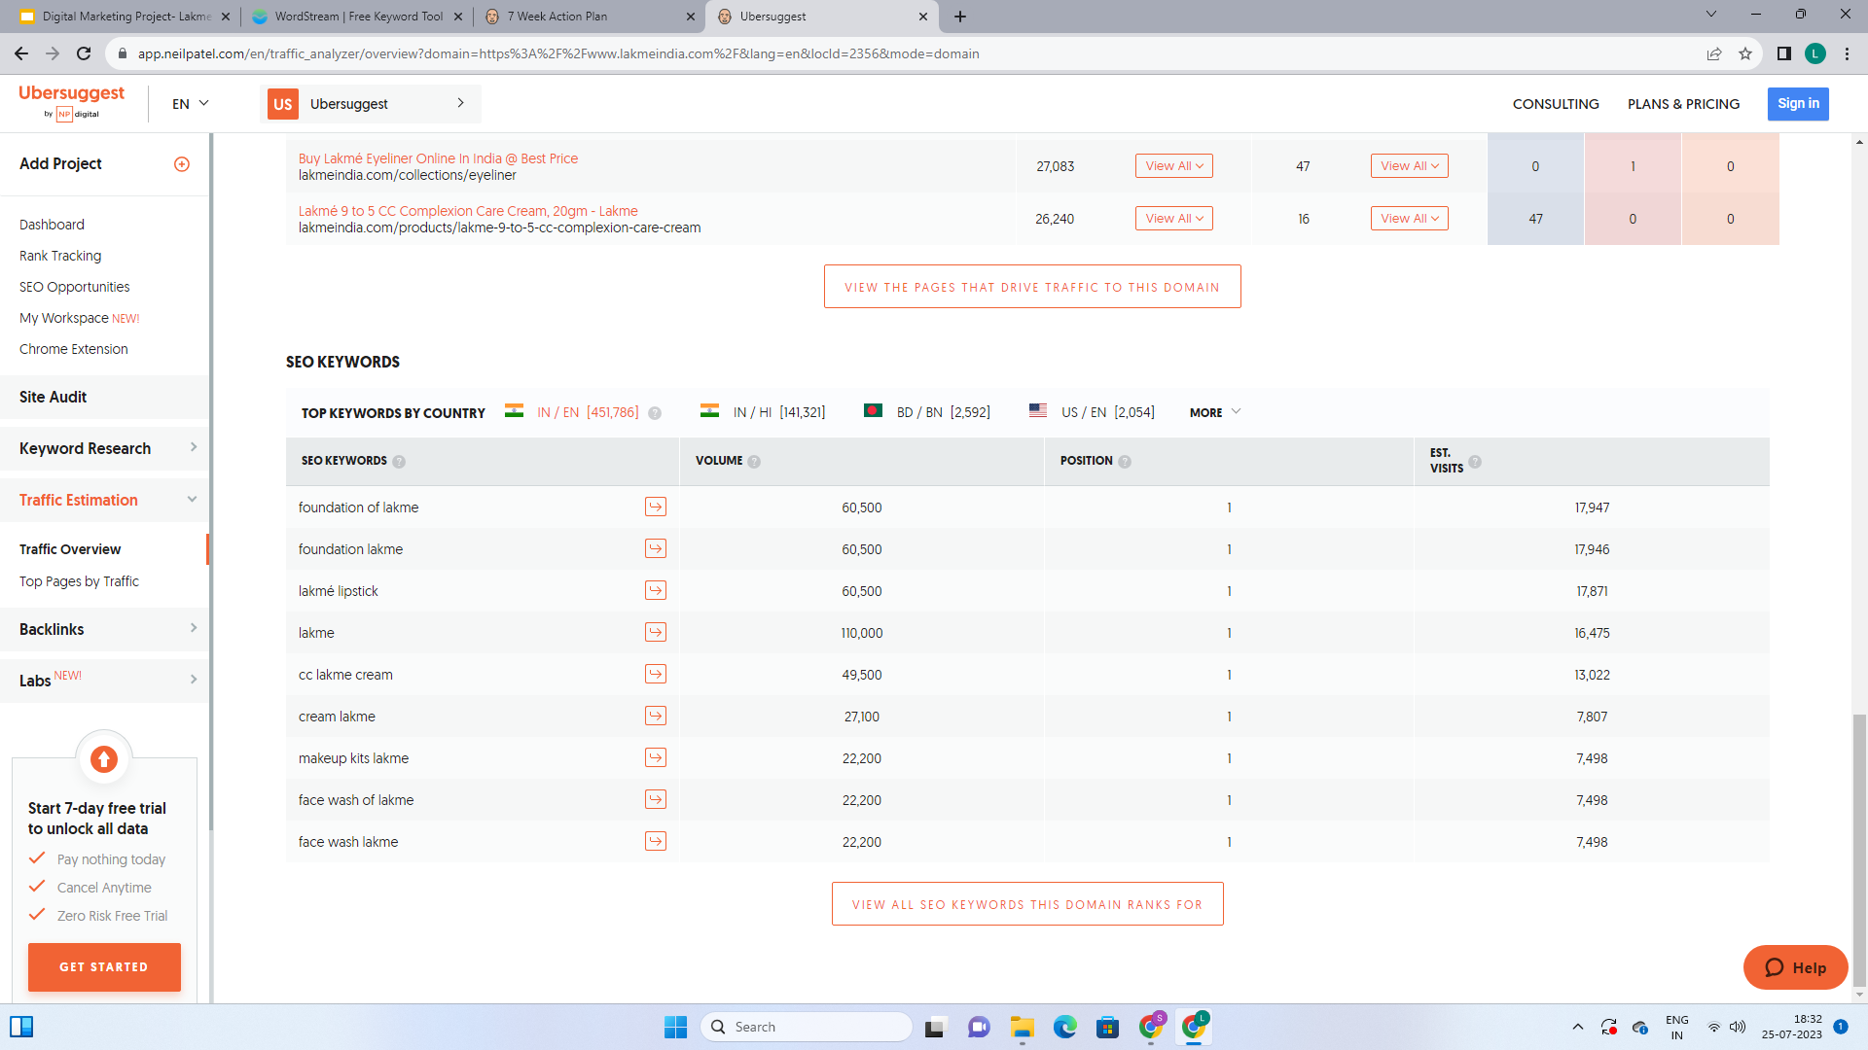
Keyword research for Lakme brand:
Main Keywords are:
Foundation of lakme
Foundation lakme
Lakme lipstick
Lakme
Cc lakme cream
Cream lakme
Makeup kits lakme
Face wash of lakme
Face wash lakme
Makeup lakme

Slide 12
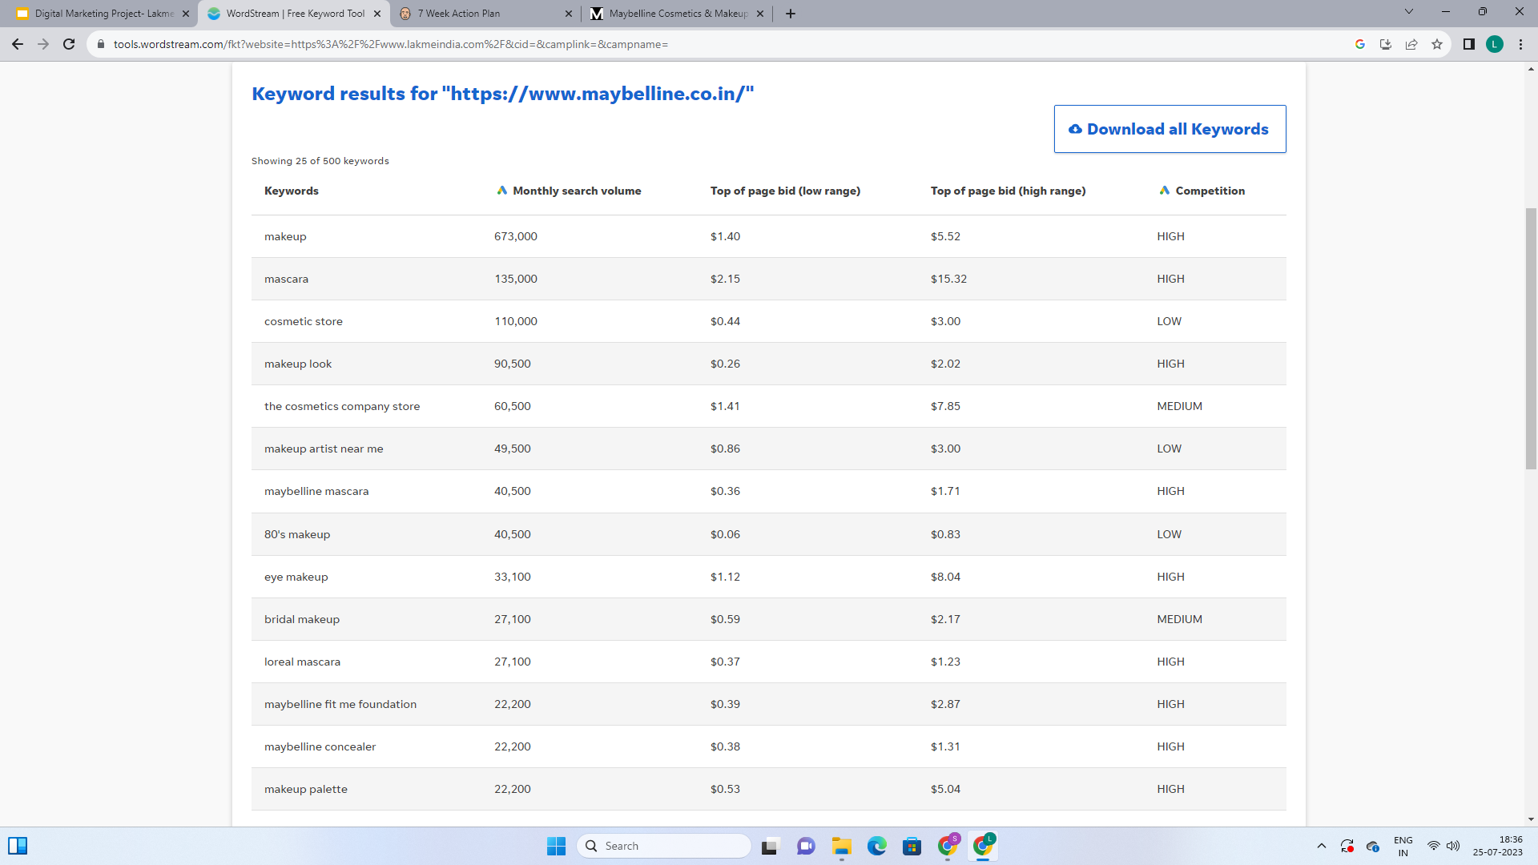
Analyze Competitor keywords (Maybelline) :
Main keywords are:
Makeup
Mascara
Cosmetic store
Makeup look
The cosmetic company store
Makeup artist near me
Maybelline mascara
Eye makeup
Maybelline fit me foundation
Maybelline concealer

Slide 13
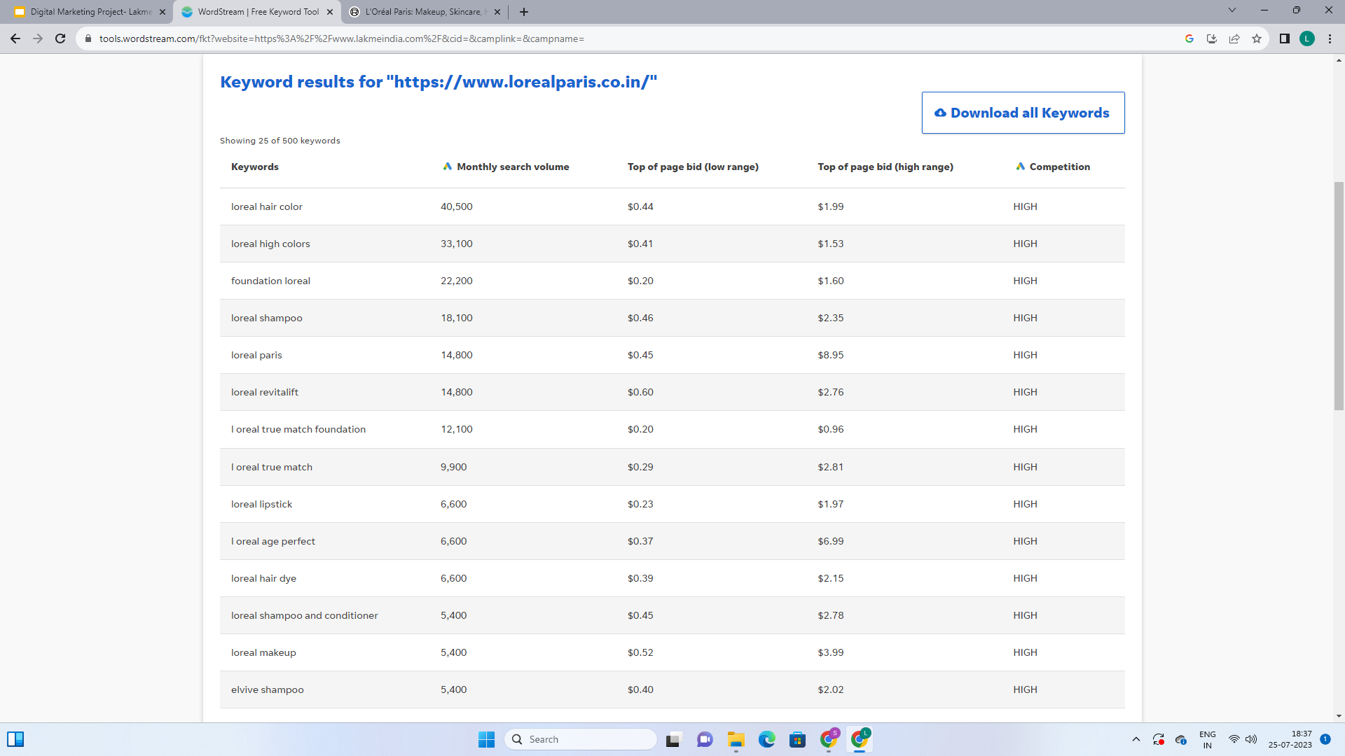
Analyze Competitor keywords (Loreal paris):
Main keywords are:
Loreal hair colour
Foundation lakme
Loreal shampoo
Loreal paris
Loreal revitalift
Loreal true match
Loreal lipstick
Loreal age perfect
Loreal hair dye
Loreal makeup

Slide 14
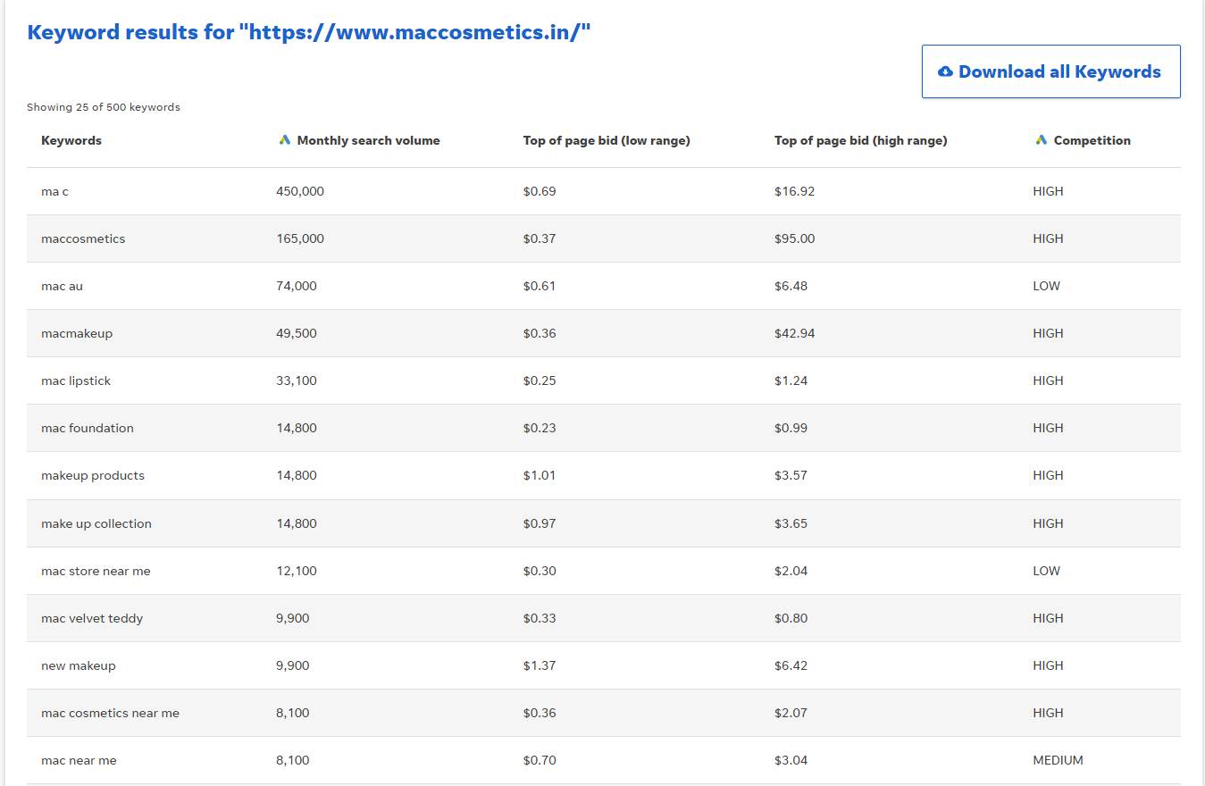
Analyze Competitor keywords (Mac cosmetics India) :
Major keywords are:
Mac
Maccosmetics
Mac makeup
Mac lipstick
Mac foundation
Makeup products
Mac store near me
Mac velvet teddy
Mac cosmetics near me
Makeup

Slide 15
Long-tail keywords Research :
Long-tail keywords are specific, longer phrases that users enter into search engines when looking for particular information, products, or services.These keywords are often less common and have lower search volumes compared to broader, more generic terms.
"Best Lakmé lipstick shades for monsoon"
"Lakmé skincare routine for dry skin"
"Lakmé bridal makeup artist near me"
"Lakmé absolute foundation review"
"Lakmé kajal for sensitive eyes"
"Affordable Lakmé makeup products online"
"Lakmé matte vs. satin finish lipsticks"
"Lakmé skincare products for acne-prone skin"
"Lakmé iconic mascara lengthening review"
"Lakmé new launch 2023: product review"
"Lakmé foundation for oily and acne-prone skin"
"Lakmé makeup tips for evening parties"
"Lakmé eye makeup for small eyes"
"Lakmé organic skincare products for sensitive skin"
"Lakmé hair care routine for damaged hair"

Slide 16
On page optimization :
Meta Title:
Discover the Best Lakme Cosmetics for Your Beauty Regimen | Lakme India
Meta Description:
Elevate your beauty routine with Lakme's top-notch cosmetics and expert beauty tips. Explore our range of makeup products and unleash your inner diva. Visit Lakme India now!
Content optimization:
Welcome to Lakme India, your ultimate destination for top-quality cosmetics and expert beauty tips. We understand the importance of feeling confident in your own skin and expressing your unique beauty. Our extensive range of Lakme products is designed to help you achieve that flawless look you've always desired. Whether you're a makeup enthusiast or a beauty beginner, we have something special for everyone!
Unleash Your Beauty Potential with Lakme Cosmetics:
Discover a wide range of Lakme cosmetics that cater to all your makeup needs. From dazzling lipsticks to long-lasting foundations and volumizing mascaras, we have it all. Our products are formulated with care and precision, ensuring that you get the best in terms of quality and performance.
Explore our makeup essentials that are suitable for all skin types and tones. Be it a subtle, everyday look or a glamorous evening makeover, Lakme has the perfect products to suit your mood and occasion.

Slide 17
Achieve a Flawless Base with Lakme Foundation:
The key to any great makeup look is a flawless base. Our Lakme foundations offer a wide range of shades and formulations, catering to different skin types and concerns. Whether you have dry, oily, or combination skin, our foundations provide seamless coverage that lasts all day long.
Magnify Your Lashes with Lakme Mascara:
Eyes are the window to the soul, and what better way to make them pop than with our volumizing Lakme mascara? Our mascaras are designed to give your lashes that extra length and volume, making your eyes look mesmerizingly beautiful.
Explore our mascara collection and find the one that suits your lash needs the best.
Expert Beauty Tips and Regimens:
Beauty is not just about the products you use but also the care you give your skin. Check out our "Beauty Tips" section to uncover professional beauty advice, skincare routines, and makeup hacks shared by industry experts.
Discover a comprehensive skincare routine that keeps your skin glowing and healthy.
At Lakme India, we believe that every individual is beautiful in their own way. Our goal is to enhance your beauty and empower you to embrace your uniqueness. Explore our range of Lakme cosmetics, follow our expert beauty tips, and embrace the journey to a more confident and beautiful you.
So what are you waiting for? Unleash the diva within you with Lakme India now!!!

Slide 18
Process of conducting keyword research :
The main goal of keyword research is to identify relevant and high-impact keywords that will drive targeted traffic to the brand's online platforms, such as the website, social media profiles, and online stores. This is the process we did to conduct keyword research for Lakme:
Understand the Brand and Objectives: Before going into keyword research, it's crucial to have a clear understanding of Lakme's brand, products, target audience, and marketing objectives.So we identified the key products, services, and themes the brand wants to promote.
Brainstorm Seed Keywords: Started by creating a list of seed keywords that are directly related to Lakme and its offerings. These are general terms that are broad and can be further expanded into more specific long-tail keywords.
Used Keyword Research Tools: We used keyword research tools to expand the seed keywords and discover potential long-tail keywords. Some tools we used are Ubersuggest, SEMrush, Moz Keyword Explorer & WordStream

Slide 19
Entered the seed keywords into these tools to generate a list of related keywords, their search volume, and competition levels. Then we identified for keywords that have a good balance of search volume and relatively lower competition.
Analyzed Competitor Keywords: We analyzed the keywords that competitors we are targeting. Tools like SEMrush helped us to identify the keywords competitors. This provided valuable insights and helped us to discover new keyword opportunities.
Monitor and Refine: Keyword research is an ongoing process.We have to continuously monitor the performance of the selected keywords and their impact on Lakme's online presence. If certain keywords are not driving the desired results, we have to consider refining our strategy and targeting different phrases.
Content Optimization: Once we had a list of targeted keywords, we incorporated them strategically into Lakme's website content, blog posts, social media posts.

Slide 20
SEO Recommendations:
These are the Seo recommendations for Lakme India website given by SEOptimer:
Optimize for Core Web Vitals
Reduce length of title tag (to between 10 to 70 characters)
Shorten meta description (to 70 to 160 characters )
Remove duplicate H1 Tags
Update links URLs o be more human and Search Engine readable
Add Alt attributes to all images
Create and link twitter account
Optimize your page for Mobile Page Speed Insights
Optimize your page for Desktop PageSpeed Insights

Slide 21
Challenges faced during the research:
High Competition: The beauty and cosmetics industry is highly competitive, with numerous brands present for top positions in search engine rankings. Finding relevant and less competitive keywords that can still drive substantial traffic was challenging.
Ever-Changing Trends: Beauty and fashion trends evolve rapidly, and consumer preferences can change quickly. Keeping up with the latest trends and adjusting our keyword strategy accordingly can be demanding.
Seasonal Variations: The demand for beauty products often varies based on seasons, events, or holidays. Keyword research needs to account for these fluctuations and adjust content accordingly.
User Intent Understanding: It's essential to decode the user's intent behind their search queries accurately. Identifying keywords that align with the stage of the buyer's journey and their specific needs can be challenging.
Voice Search Optimization: With the increasing popularity of voice-activated devices, optimizing for voice search requires understanding and targeting conversational queries.
Mobile Optimization: Given the rise of mobile usage, optimizing the Lakme India website for mobile devices is crucial for user experience and search rankings.
Content Variety: The beauty industry demands a diverse range of content, such as tutorials, product reviews, skincare guides, and more. Ensuring that relevant keywords are incorporated into each type of content can be a challenge.

Slide 22
Insights gained from this process:
User Intent and Behavior: By analyzing keyword data, we can understand the intent behind users' search queries. This insight helps in creating content that directly addresses users' needs and preferences, leading to better engagement and conversions
Competitor Analysis: Keyword research allows us to identify the keywords their competitors are targeting. Understanding competitor strategies can help in refining their own approach and finding untapped opportunities.
High-Performing Content: By analyzing keywords that drive the most traffic and conversions, we can identify their best-performing content. This insight can be used to optimize existing content or create similar content to attract more visitors.
Insights for Content Creation:Keyword research provides insights into the type of content users are looking for. We can identify popular questions, pain points, and interests to create informative and relevant content that satisfies user needs.
User Experience Improvements: Analyzing keyword data can reveal potential user experience issues. By addressing these issues, we can enhance the overall website experience and encourage user engagement.
On-Page Optimization: SEO research highlights opportunities for on-page optimization, including title tags, meta descriptions, headers, and internal linking. Properly optimized pages can improve search engine rankings and click-through rates.

Slide 23
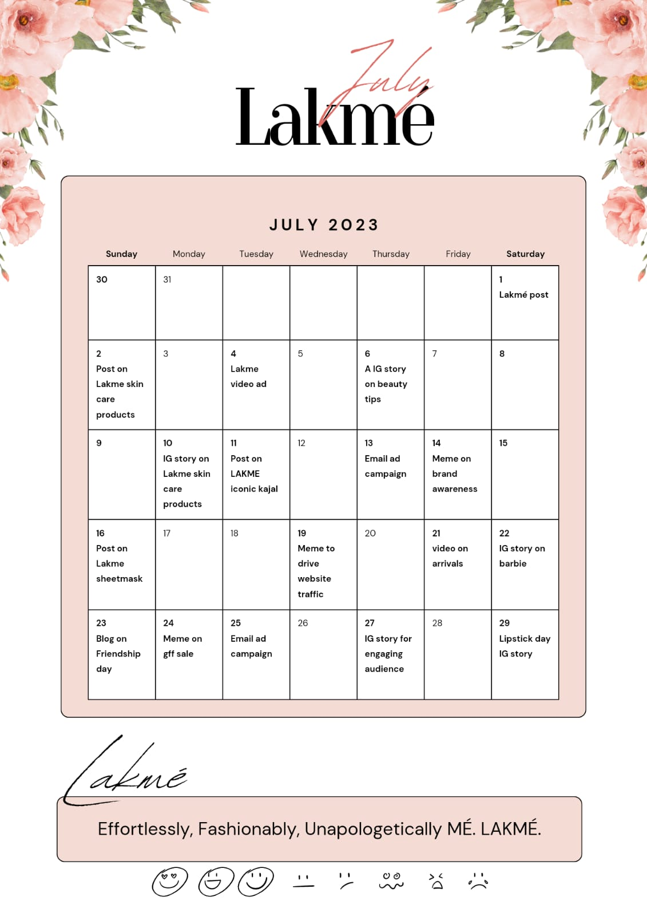
Part 3: Content Ideas and Marketing Strategies
Content Idea Generation & Strategy: Create a content calendar for the remaining month of July by brainstorming content themes, exploring various formats like blog posts, videos, infographics, podcasts, and interactive quizzes, and scheduling publication dates mainly on Facebook & Instagram. And include the strategy, aim and the idea behind these posts and story
Content Calendar Example (Try creating a table for the month of July)

Slide 24
Format 1: Blog Post
Aim: To boost SEO and to provide information regarding the products of Lakme
Date: 23rd July, 2023
Idea: On the eve of friendship day Lakme wants to wish its audience and also provide them with information about the variety of products available.
Format 2: Videos
Aim: To provide visually appealing content to the audience and for brand awareness
Date: 21st July, 2023
Idea: The main idea behind this is to provide information regarding the new launches and drive customers to the website.
We also created another video advertisement for our brand and posted it on our instagram page- 4th july

Slide 25
Format 3: Creative (Meme)
Aim: To engage the audience with fun content and also promoting our brand simultaneously.
Date: 14th, 19th & 24th of July 2023
Idea: What we observed is, Lakme always tries to give more professional content than fun content, so we wanted to provide some fun and engaging content as audience like it that way. Memes are the best strategy we could use for this.
Format 4: Instagram Stories
Aim: To promote our brand and create engaged online communities
Date: Posted regularly
Idea: The main idea is to be more interactive with the audience and understand what kind of content they are interested in. This was done by creating Q&A, polls etc…

Slide 26
Part 3: Content Ideas and Marketing Strategies
Reflect on the content ideas and marketing strategies process, discussing the challenges encountered and lessons learned.
Content ideas and marketing strategies:
As a beauty brand Lakme objectives are quite clear. The content ideas that we decided are blog post, video, creatives and instagram stories. The main strategy we used is to create brand awareness, provide information about new launches and engage the audience with the trendy topics like Barbie etc.
Challenge Faced:
The main challenge that we faced is choosing the products to promote, as there is a wide range of products available.

Slide 27
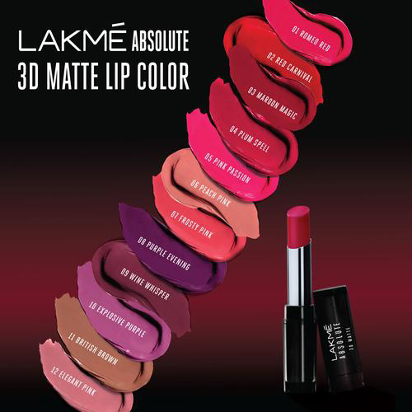
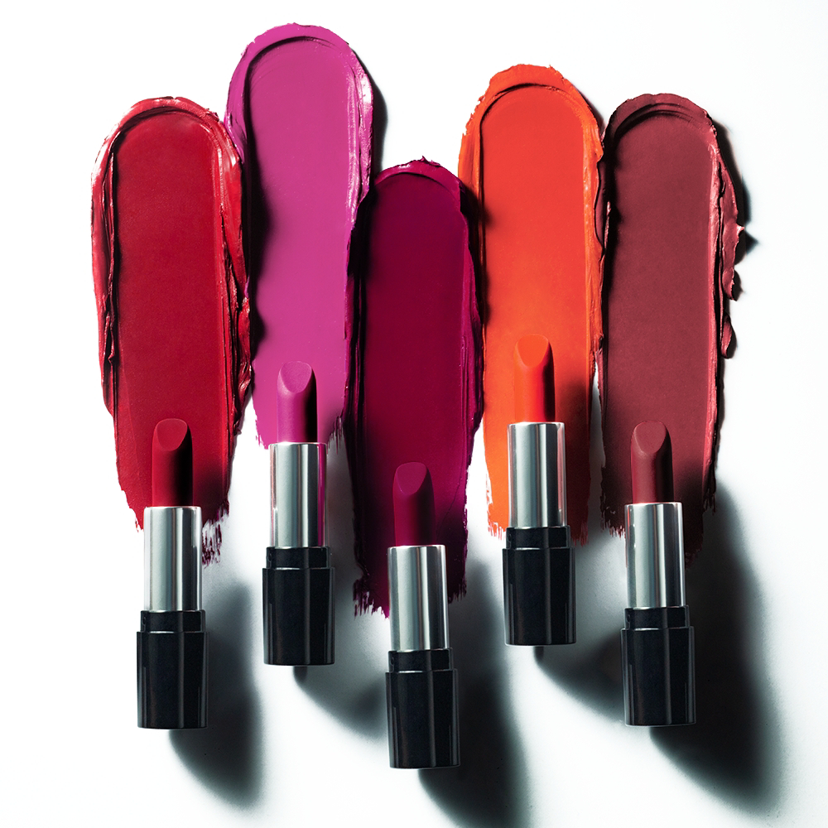
Format 1:
Blog Title : Celebrate Friendship Day with Stunning Lakmé Cosmetics Gifts✨✨
Friendship Day is just around the corner, and what better way to show your appreciation for your best friends than with thoughtful and beautiful gifts? If your besties love cosmetics and makeup, then Lakmé has got you covered!! In this blog, we've compiled a list of fabulous Lakmé cosmetics gift ideas that will leave your friends feeling pampered and amazed on this special day.
1. Lakmé Absolute Matte Revolution Lip Color Set : Lipsticks are basic in every makeup lover's collection, and the Lakmé Absolute Matte Revolution Lip Color Set is an ideal gift. This set features a range of stunning matte shades that suit various skin tones. Your friends will adore the smooth and long-lasting formula that adds a touch of elegance to any look.

Slide 28
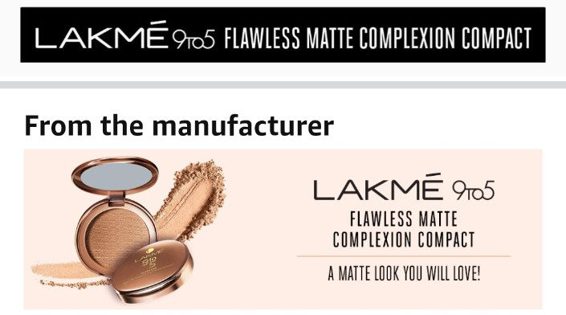
2. Lakmé 9 to 5 Flawless Matte Complexion Compact : Help your friends achieve a flawless complexion with the Lakmé 9 to 5 Flawless Matte Complexion Compact. This compact not only provides excellent coverage but also keeps the skin looking fresh and matte throughout the day. It's a must-have in every makeup bag!
3. Lakmé Eyeconic Kajal : Draw attention to your friends' beautiful eyes with the Lakmé Eyeconic Kajal. This intensely pigmented kajal glides on effortlessly and stays smudge-free for hours. Whether they prefer a subtle or bold look, this kajal will be their go-to for defining their eyes.

Slide 29
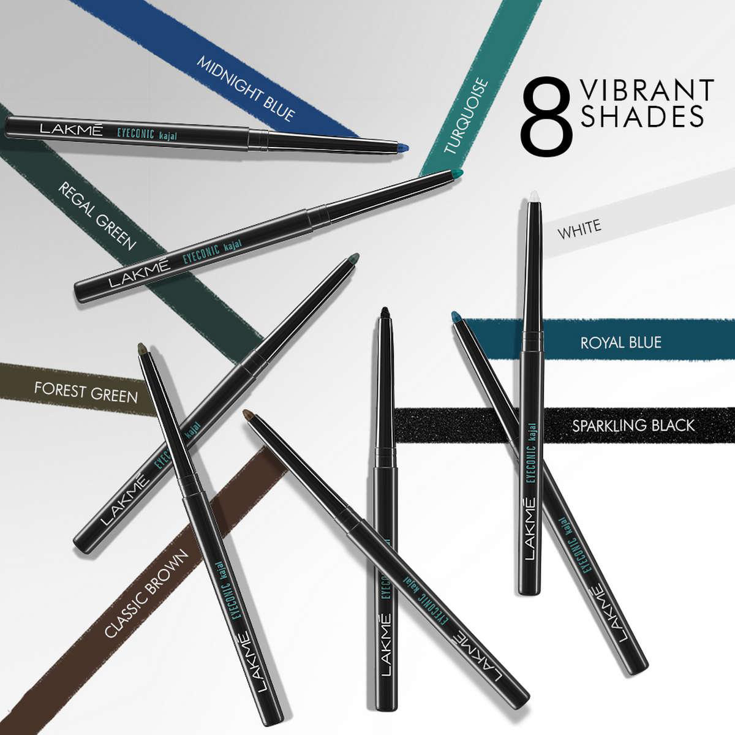

4. Lakmé Absolute Precision Liquid Liner : For friends who love experimenting with eyeliner styles, the Lakmé Absolute Precision Liquid Liner is the perfect gift. It’s fine brush tip allows for precise application, and its quick-drying formula ensures a long-lasting, smudge-proof look.

Slide 30

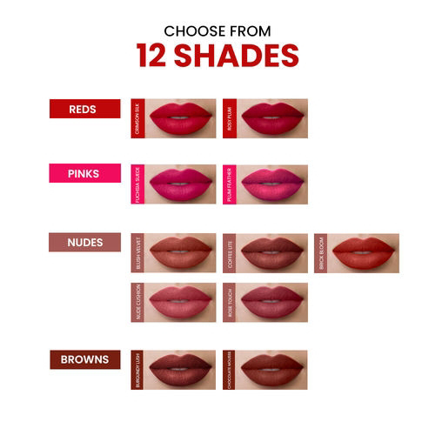
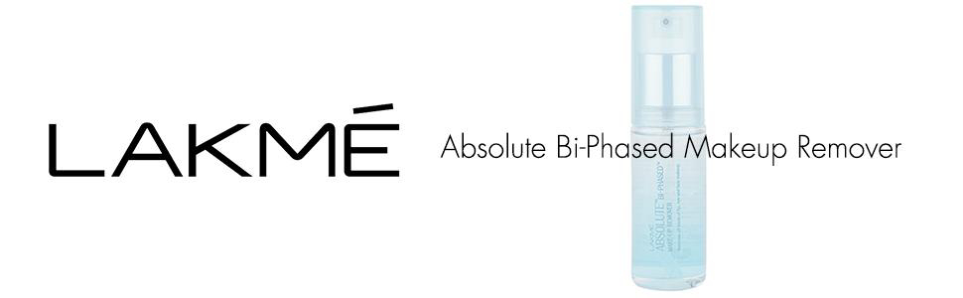
5. Lakmé 9 to 5 Weightless Matte Mousse Lip & Cheek Color : Give your friends the gift of versatility with the Lakmé 9 to 5 Weightless Matte Mousse Lip & Cheek Color. This dual-purpose product can be used as a lip color or a blush, providing a soft, velvety finish to the lips and cheeks.
6. Lakmé Absolute Bi-Phased Makeup Remover : Taking off makeup at the end of the day is essential for maintaining healthy skin. The Lakmé Absolute Bi-Phased Makeup Remover effectively removes even the most stubborn makeup, leaving the skin feeling refreshed and clean

Slide 31
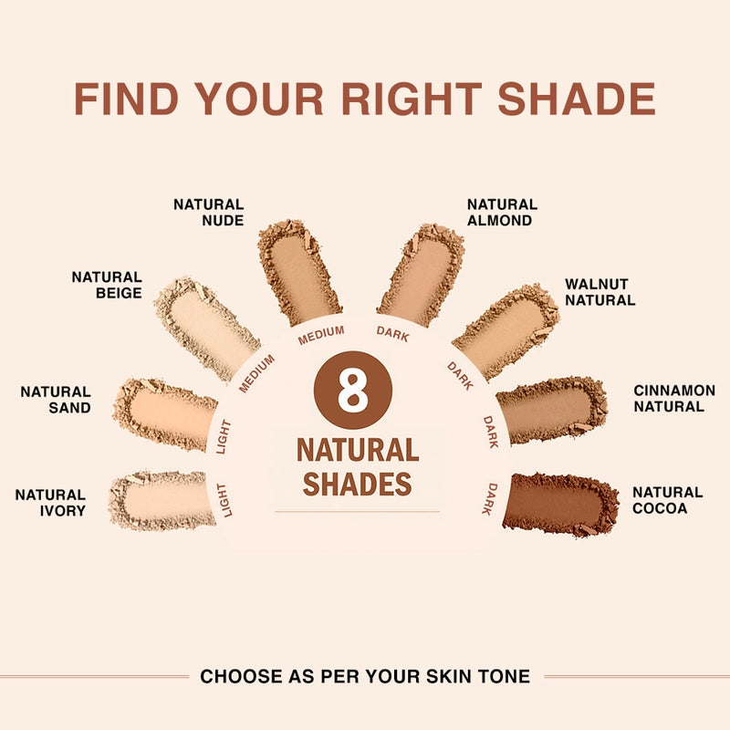

7. Lakmé 9 to 5 Primer + Matte Powder Foundation : For friends who prefer a lightweight base, the Lakmé 9 to 5 Primer + Matte Powder Foundation is an excellent choice. It not only primes the skin but also offers buildable coverage for a natural, matte finish.
8. Lakmé Absolute Shine Liquid Eye Liner : If your friends love experimenting with eye looks, the Lakmé Absolute Shine Liquid Eye Liner will surely impress them. It comes in various shades with a glossy finish, perfect for adding a pop of color to their eye makeup.

Slide 32
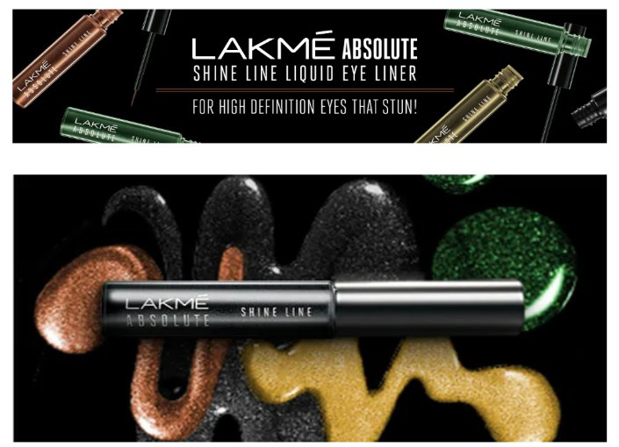
This Friendship Day, express your love and appreciation to your best friends with thoughtful Lakmé cosmetics gifts. From lip colors to eyeliners and foundations, Lakmé offers a wide range of high-quality products that your friends will cherish. Celebrate the bond of friendship by gifting them these beautiful makeup essentials, making their day extra special and memorable.
Happy Friendship Day💕

Slide 33
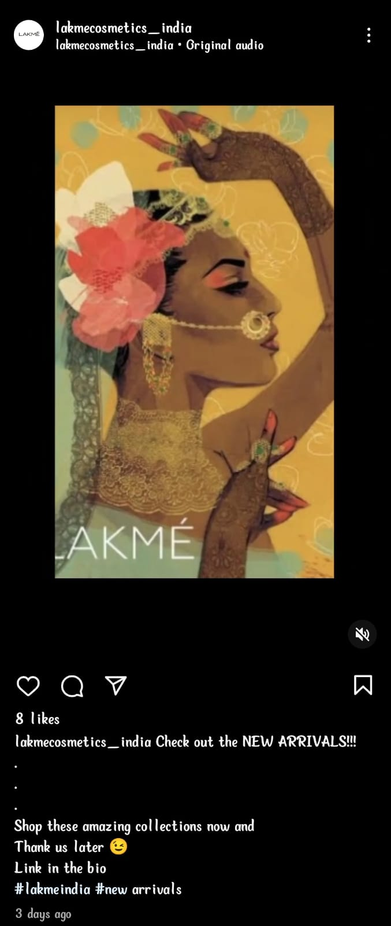
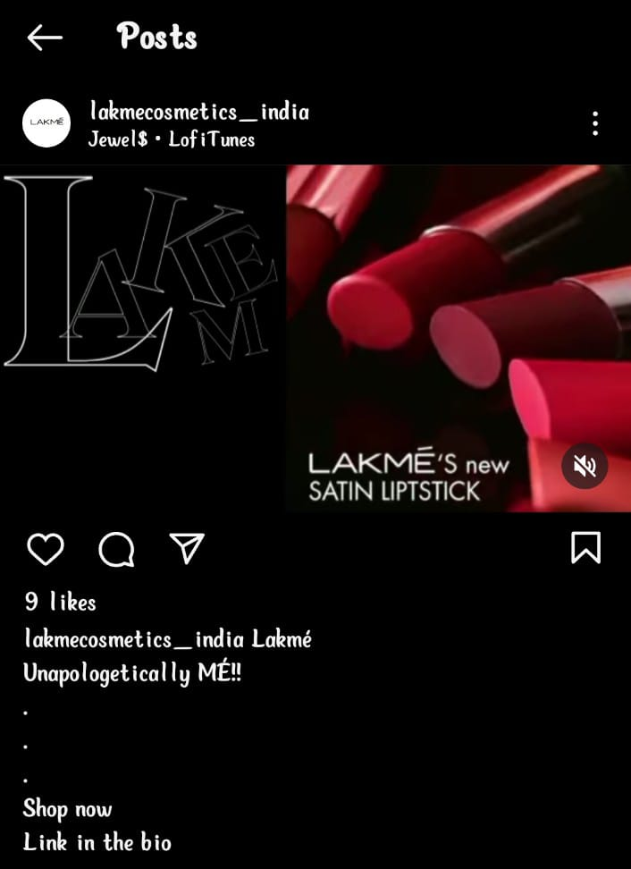
Format 2:
Video : We created 2 videos
Our instagram page: lakmecosmetics_india
The first video is for about the new arrivals.
Video Link
This video is an advertisement.
AD Link

Slide 34
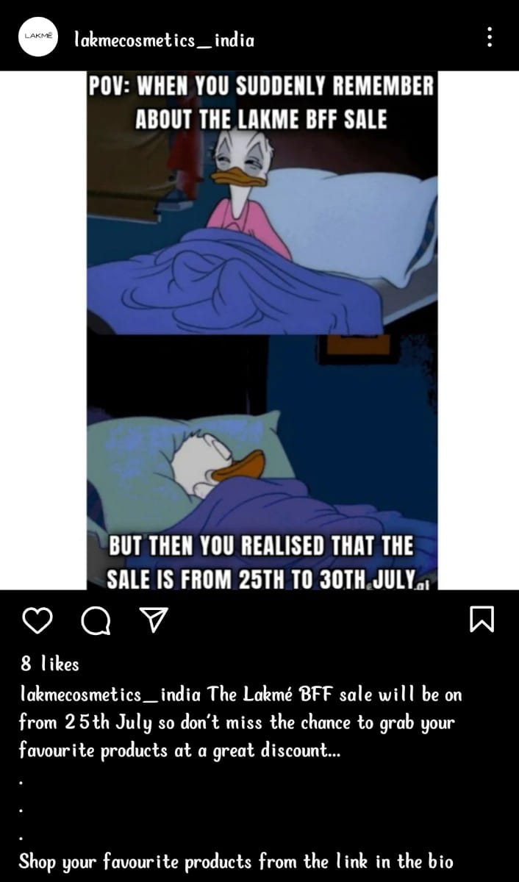
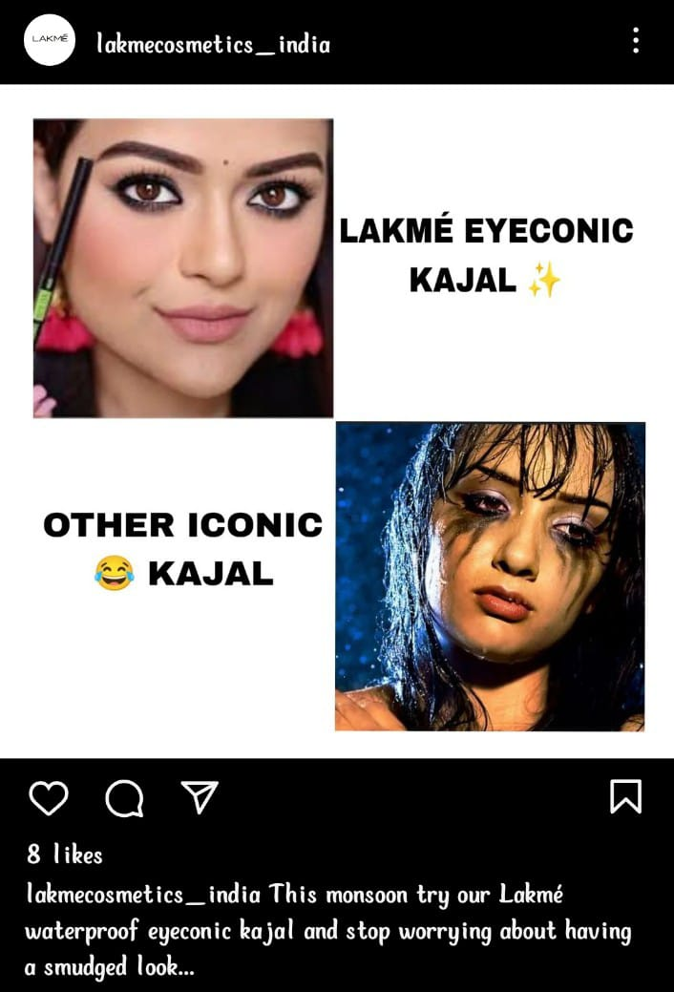
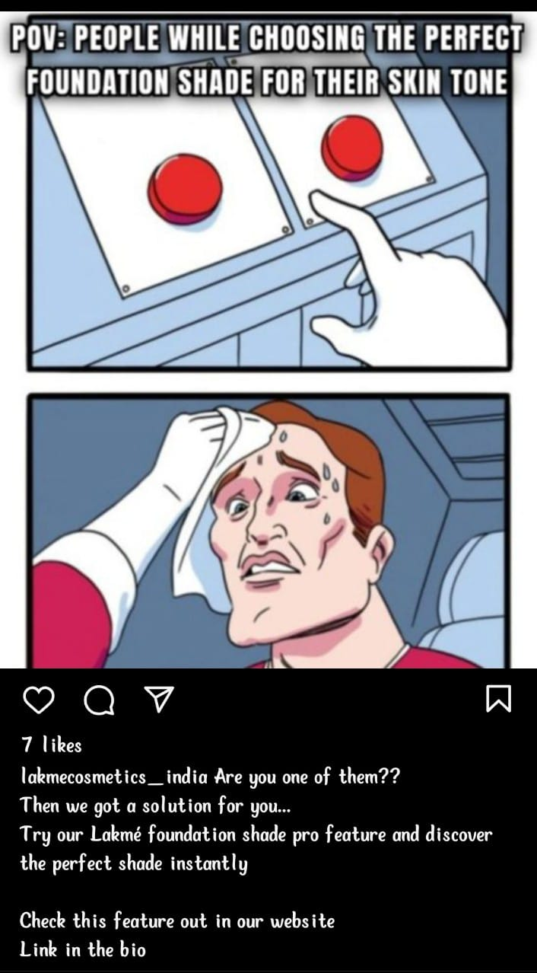
Format 3:
Creative (Memes):
Aim: The main of this meme is to engage
the audience and to provide information
about the upcoming sale.
Aim: This meme is created for product
awareness and to provide fun content to the audience
Aim: The aim of this content is to drive website
traffic and for increasing brand awareness.

Slide 35
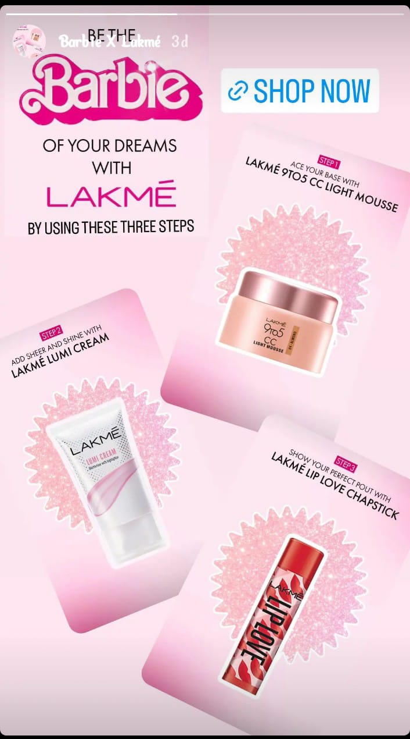
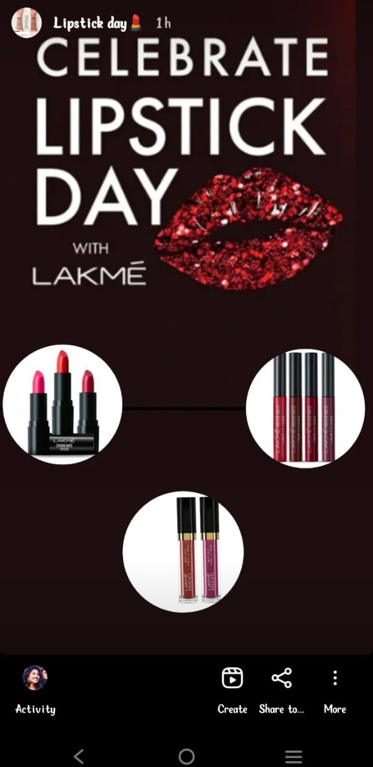
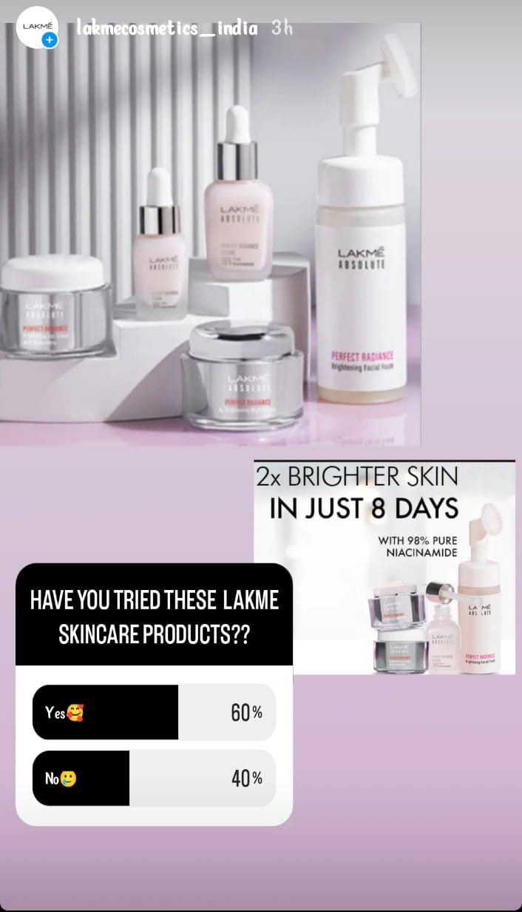
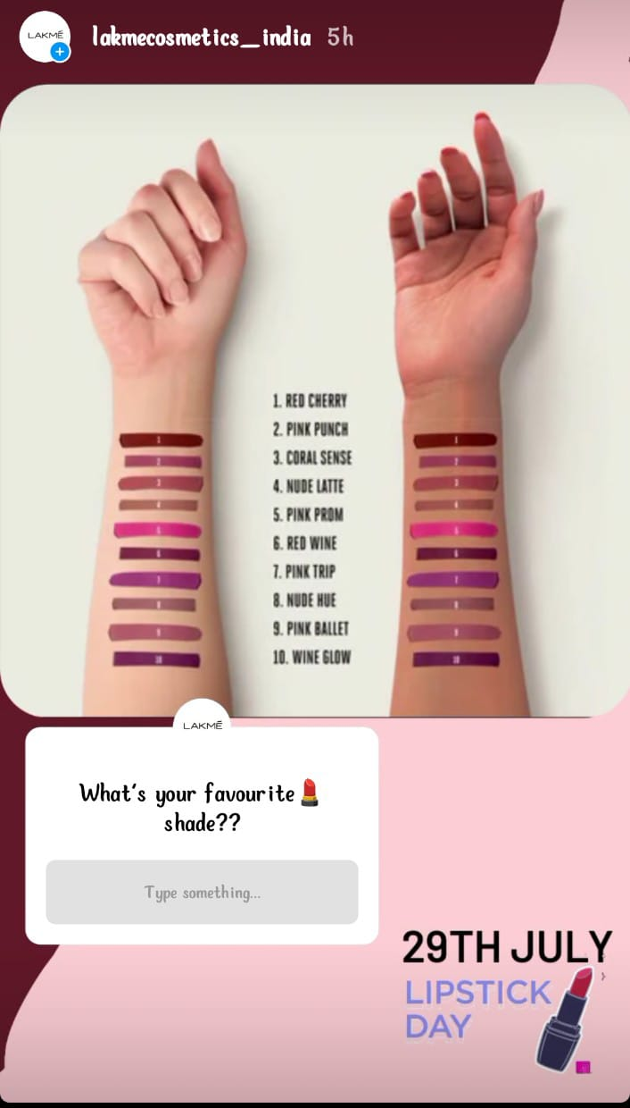
Format 4:
Instagram stories - lakmecosmetics_india

Slide 36
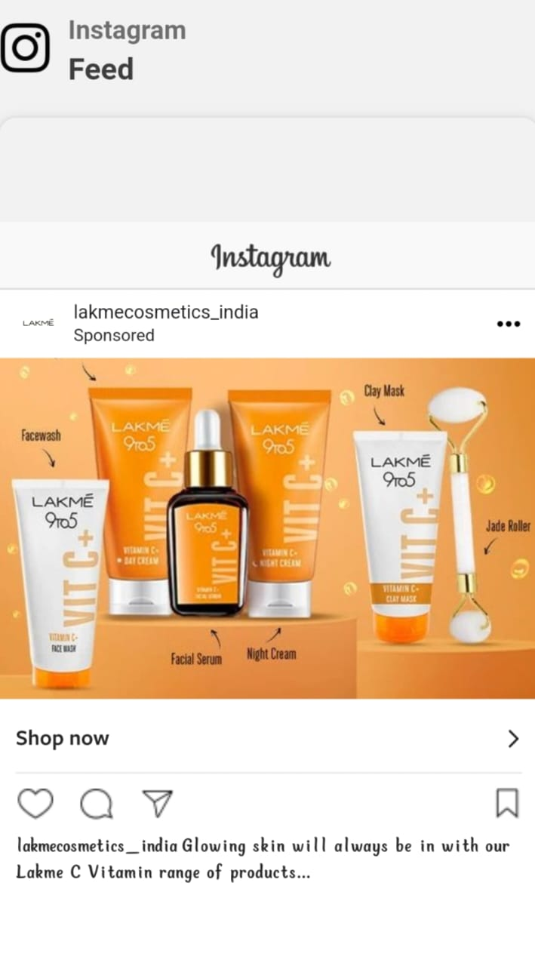
Part 4: Content Creation and Curation (Post creations, Designs/Video Editing, Ad Campaigns over Social Media and Email Ideation and Creation)
Social media Ad Campaign - 1:
Aim: Brand awareness
Content:
We used the Lakme Vitamin C
range of products to do this
campaign.
Target audience: Female
Age (18 to 55 years)

Slide 37
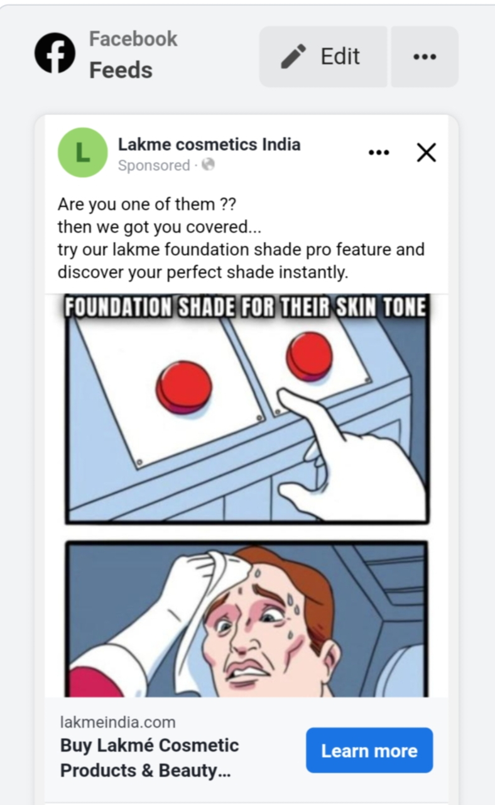
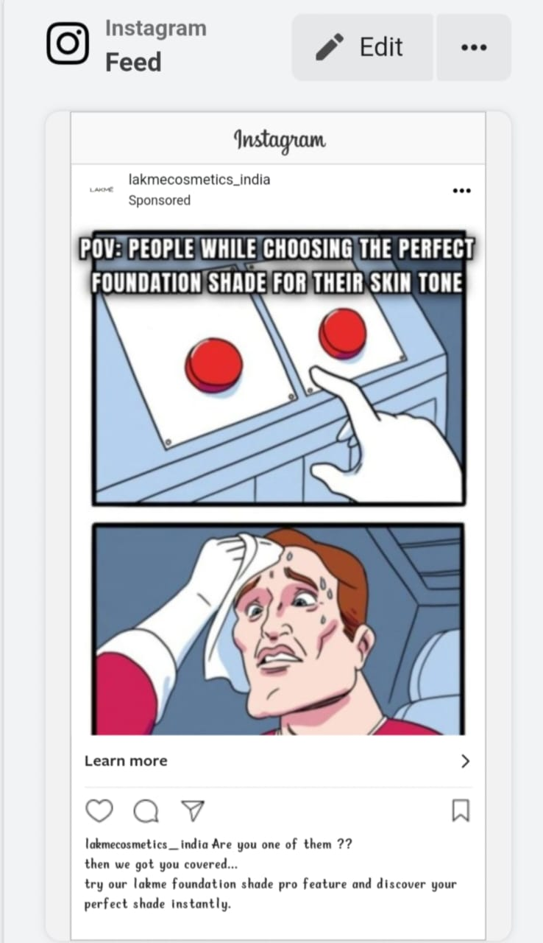
Social media Ad Campaign- 2 :
Aim: Driving website
traffic
Content:
To drive the website
traffic we used the lakme
foundation shade pro
feature.
Target audience: Female
Age (18 to 55 years)

Slide 38
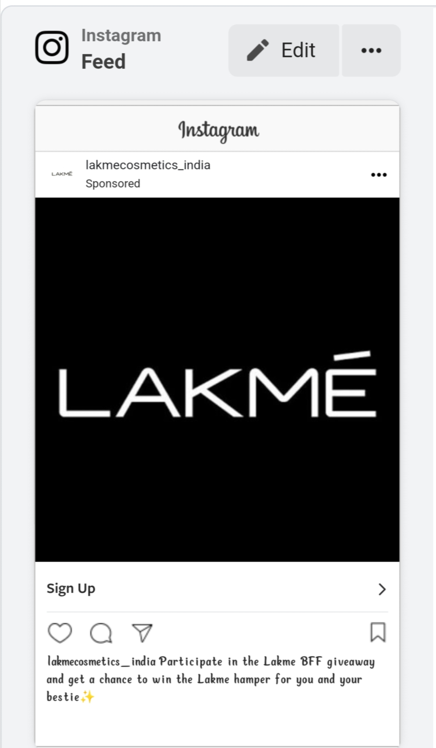
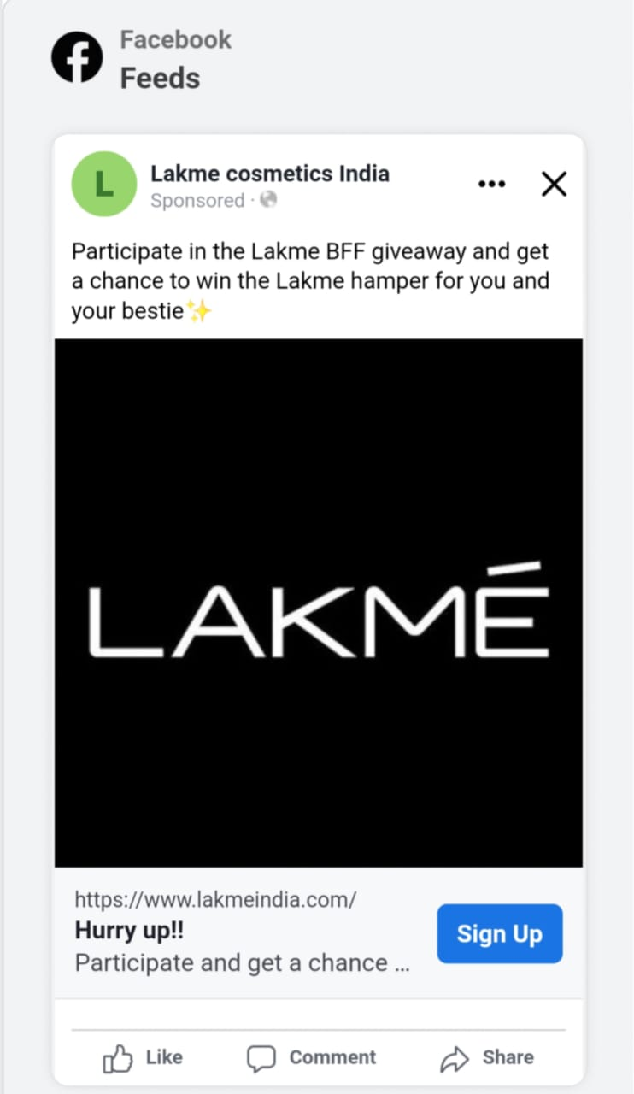
Social media Ad Campaign - 3:
Aim: Lead generation
Content:
On this friendship day, the
BFF giveaway is live, we
wanted to generate leads
through this giveaway.
Target audience: Female
Age (18 to 55 years)

Slide 39
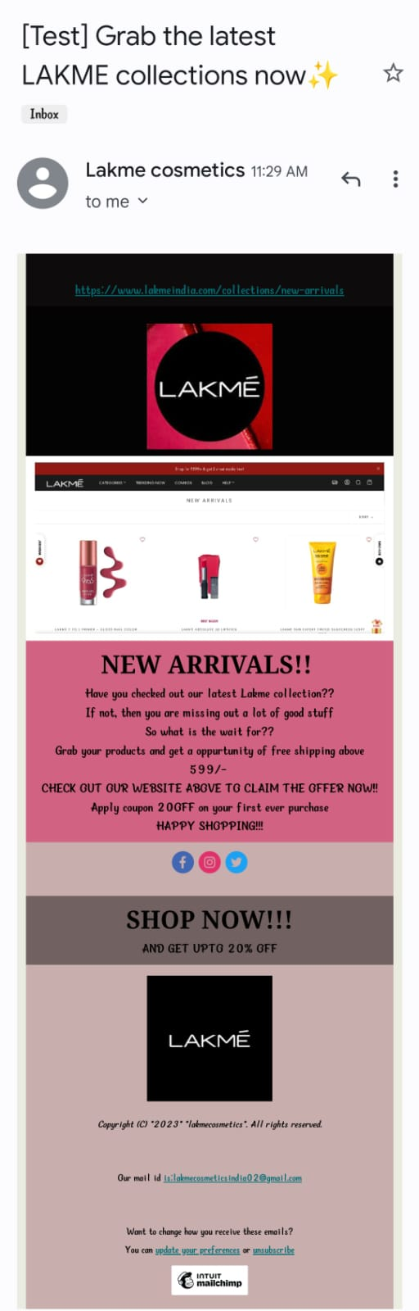
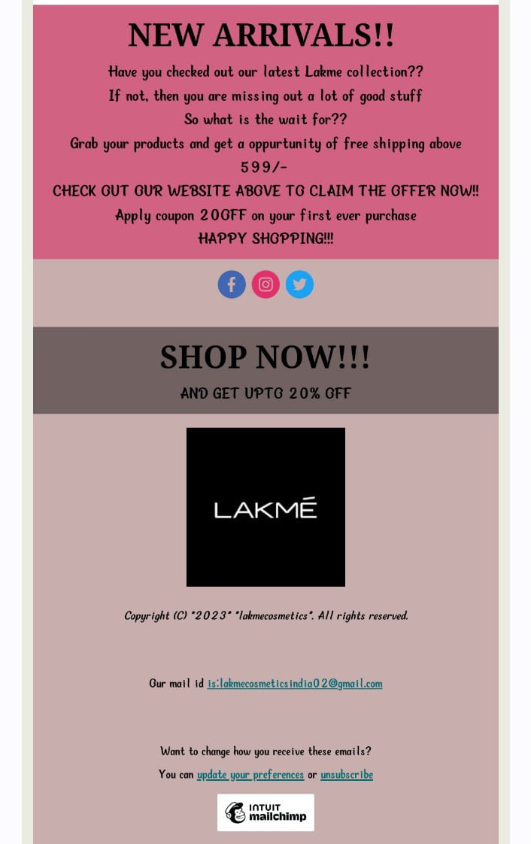
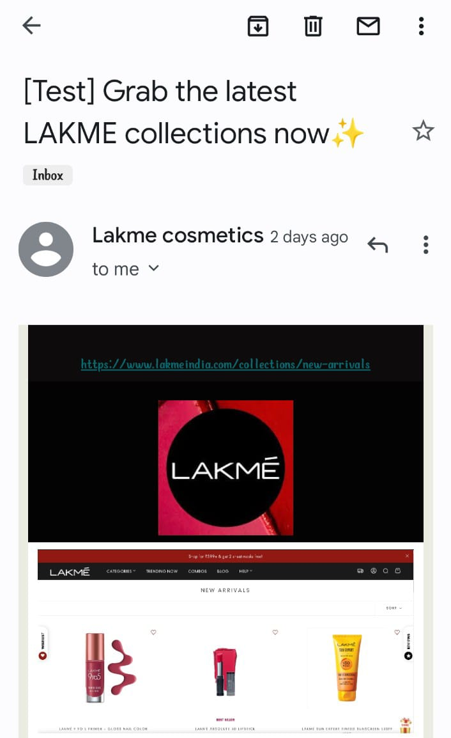
Email Ad Campaign 1 - Brand Awareness

Slide 40
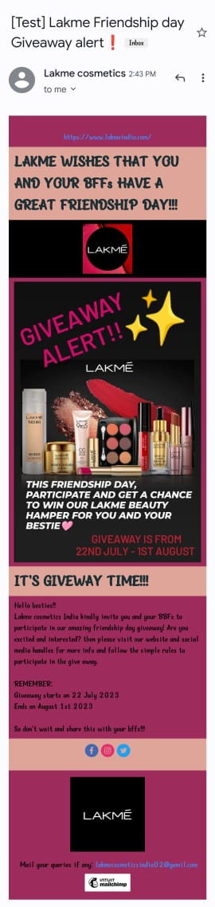
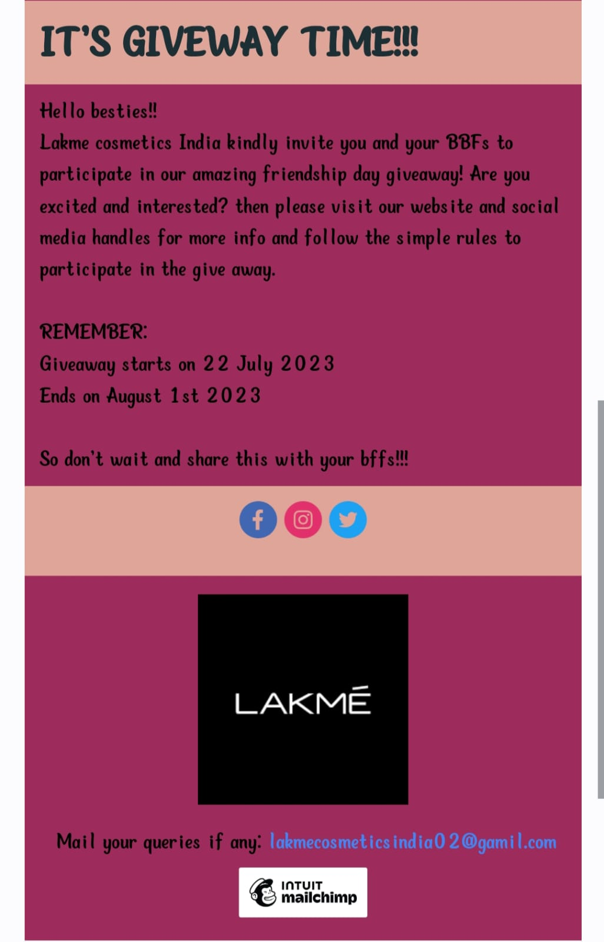
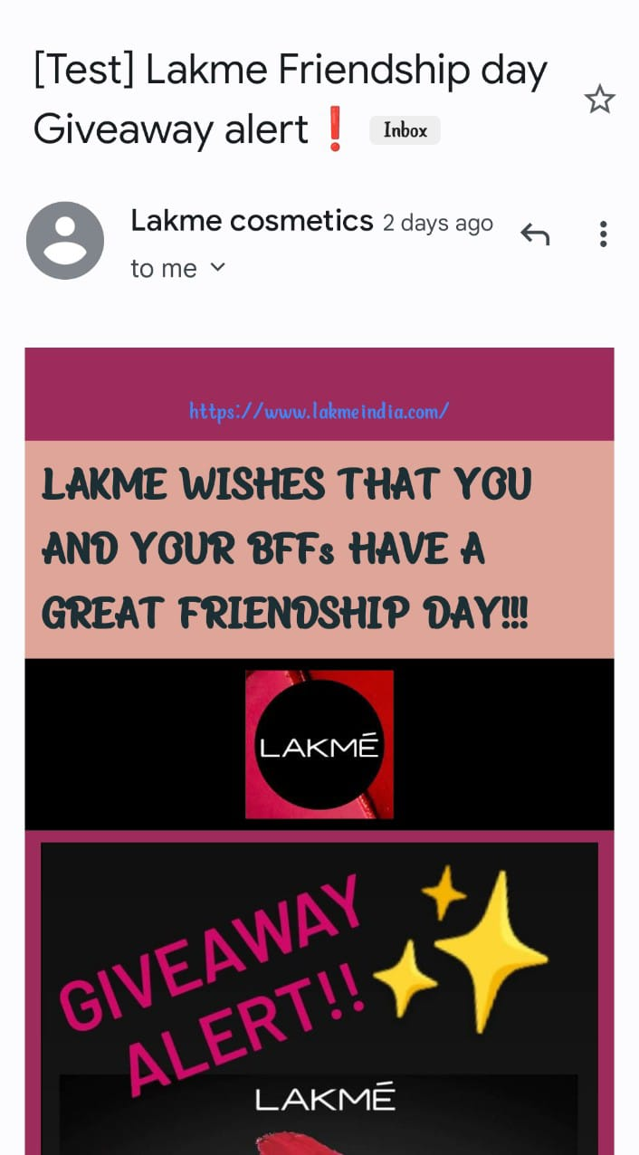
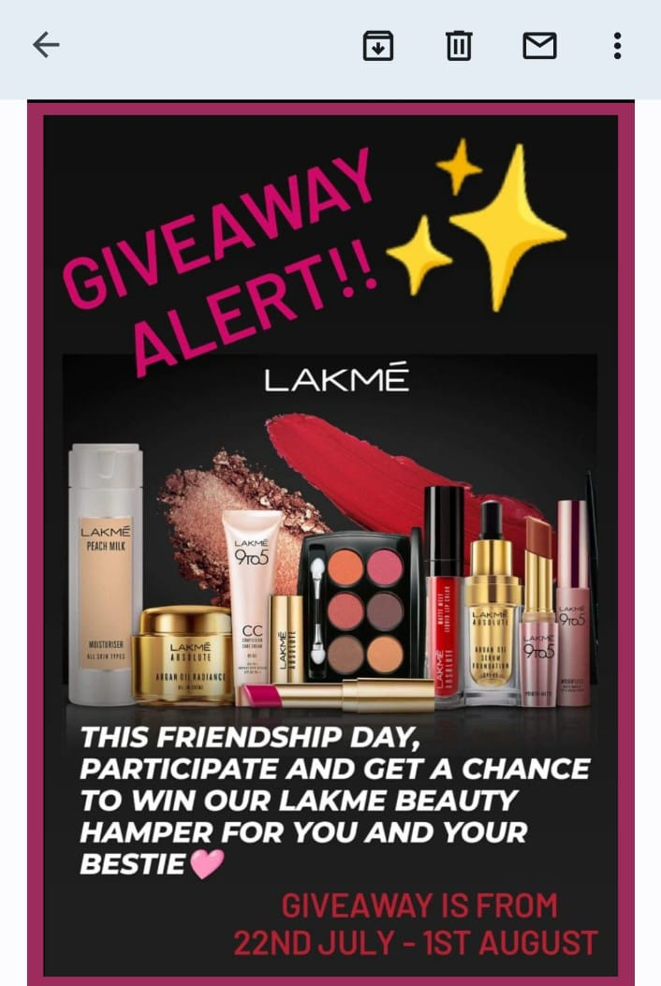
Email Ad Campaign 2 - Lead Generation

Slide 41
Part 4: Content Creation and Curation (Post creations, Designs/Video
Editing, Ad Campaigns over Social Media and Email Ideation and Creation)
Content creation and curation process:
Research and Planning
Ideation and writing
Editing and Optimization
Publishing and Promotion
Monitor and Analyze
Challenges faced during the process:
Time Constraints
Consistency
Understanding the target audience and producing content
Content Variety
Staying Updated

Slide 42
Lessons learnt through this process:
Audience Preferences and Interests: By analyzing the performance of different types of content, we understood what content connects most with the audience. This insight helped us to tailor content that match audience preferences and interests.
Content Format Effectiveness: Digital marketers can determine which content formats (e.g., blog posts, videos, creatives) are most effective at engaging the audience and driving desired actions. This knowledge allows us to focus on producing the most impactful formats.
Feedback: Engaging with audiences around curated content can provide valuable feedback and insights into their preferences, dislikes, and opinions. We can use this feedback to refine the messaging and content direction.
Conversion Insights: Tracking content performance through to conversion points helped us to understand which content contributes the most.
Content Repurposing Opportunities: Analyzing which content performs well can highlight opportunities for repurposing content into different formats or updating older content to make it relevant again.

